Slide 1
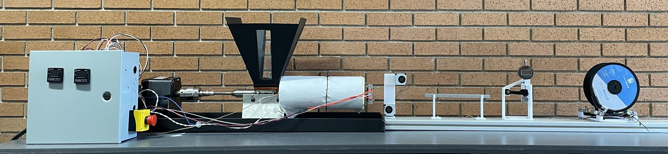
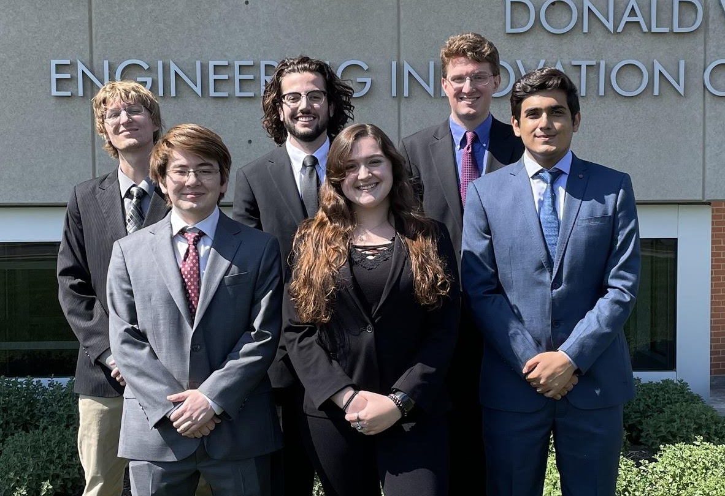


Filament Extruder
Objective
The Filament Extruder is an open source polylactic acid (PLA) recycling system that will take ground up plastic, melt it down, and extrude it into useable 3D printer filament. The system will be helpful to local schools and the Valpo Community through saving costs by using recycled filament instead of buying new material. The customer, Vidette Makes, will be using the system as an educational tool for school aged children. Preset temperatures and speed values for the optimal extrusion of PLA are built into the system, but both parameters are also manually adjustable. Thus in the future if the customer desires, he can use the system to recycle other filament types as well.
System Design
Motor & Coupler | Hopper | Heating System | Dial Indicator
The high torque motor pushes the filament through the system, and a flex coupler connect the motor and screw and ensures correct alignment. | The large hopper funnels the plastic into the heated barrel and filters out large objects or foreign material. When fully filled, the hopper allows the system to run for hours. | The cable heater around the barrel and beneath the insulation works in tandem with the cartridge heaters in the nozzle to melt the plastic pellets at temperatures upwards of 190°C. | The dial indicator with a digital output reads the diameter of the extruded plastic to check if the output is satisfactory and within usable tolerance.
System Control | Screw & Barrel | Cooling Fans | Spooler
The system is controlled through a central Arduino Mega and makes adjustments to the spooler speed to ensure optimal filament diameter. | The tapered screw feeds the plastic through the barrel and creates pressure to force the plastic out of the nozzle to form filament close to tolerance. | The fans cool the filament and allow it to not deform when run through the diameter sensor. | The spooler carefully winds and tensions the filament to get it in tolerance as it is extruded.
Team
Back, left to right:
Front, left to right:
Advisor:
Alec Rich
Connor Cassaro
Jonathan Bayert
Oscar Benbow
Nicole Pomeroy
Munib Rashad
Dr. Daniel Blood

